Slide 1
“The Prohibition of Excessive Pricing: Inherent Difficulties, Potential Mistakes, and Conditions for Application”
Yossi Spiegel
4th Cambridge Symposium on Competition Policy, March 10, 2025

Slide 2

"Alon Ohel is chained, starved, and injured in a tunnel"

Slide 3
Article 102
Any abuse by one or more undertakings of a dominant position within the internal market or in a substantial part of it shall be prohibited as incompatible with the internal market in so far as it may affect trade between Member States.
Such abuse may, in particular, consist in:
(a) directly or indirectly imposing unfair purchase or selling prices or other unfair trading conditions;
(b) limiting production, markets or technical development to the prejudice of consumers;
(c) applying dissimilar conditions to equivalent transactions with other trading parties, thereby placing them at a competitive disadvantage;
(d) making the conclusion of contracts subject to acceptance by the other parties of supplementary obligations which, by their nature or according to commercial usage, have no connection with the subject of such contracts.

Slide 4
Article 102
Any abuse by one or more undertakings of a dominant position within the internal market or in a substantial part of it shall be prohibited as incompatible with the internal market in so far as it may affect trade between Member States.
Such abuse may, in particular, consist in:
(a) directly or indirectly imposing unfair purchase or selling prices or other unfair trading conditions;
(b) limiting production, markets or technical development to the prejudice of consumers;
(c) applying dissimilar conditions to equivalent transactions with other trading parties, thereby placing them at a competitive disadvantage;
(d) making the conclusion of contracts subject to acceptance by the other parties of supplementary obligations which, by their nature or according to commercial usage, have no connection with the subject of such contracts.

Slide 5
What does it mean?
United Brands case, 1976
  Chiquita bananas were sold in Belgium, the Netherlands, Germany, and Demark at much higher prices than in Ireland and relative to the prices of unbranded bananas
"The questions therefore to be determined are whether the difference between the costs actually incurred and the price actually charged is excessive, and, if the answer to this question is in the affirmative, whether a price has been imposed which is either unfair in itself or when compared to competing products."

Slide 6
What does it mean?
United Brands case, 1976
  Chiquita bananas were sold in Belgium, the Netherlands, Germany, and Demark at much higher prices than in Ireland and relative to the prices of unbranded bananas
"The questions therefore to be determined are whether the difference between the costs actually incurred and the price actually charged is excessive, and, if the answer to this question is in the affirmative, whether a price has been imposed which is either unfair in itself or when compared to competing products."
Two-pronged test
  Excessive
  Unfair
What's excessive and what's unfair is a mystery

Slide 7
Werden, European Competition Journal, 2021
"More than six decades after the EEC Treaty entered into force, and more than four decades after the CJEU provided what was treated as a test for the excessive pricing infringement, we now know that there is no particular test: Neither rules nor standards define exploitative abuses, and competition agencies enjoy a “margin of manoeuver” in fashioning tests for specific cases."

Slide 8
Werden, European Competition Journal, 2021
"More than six decades after the EEC Treaty entered into force, and more than four decades after the CJEU provided what was treated as a test for the excessive pricing infringement, we now know that there is no particular test: Neither rules nor standards define exploitative abuses, and competition agencies enjoy a “margin of manoeuver” in fashioning tests for specific cases."
Very tempting to use the law to curb high prices
We just do not how to do that

Slide 9
Werden, European Competition Journal, 2021
"Exploitative abuse of a dominant position is at least ironic and perhaps even tragic: The infringement is unfairness, yet punishment is meted out without fair notice. For example, agencies do not announce what prices are fair or how fairness will be judged. Instead, they occasionally announce fines for charging the wrong prices. This situation offends basic precepts of fairness enshrined in the US Constitution, if not in EU treaties. A century ago, the Supreme Court of the United States voided for vagueness a federal law prohibiting “any unjust or unreasonable” price, and the Court now regularly declares ordinary criminal laws to be unconstitutionally vague."
Ex post regulation
Hard to have bright rules so intervention introduces considerable uncertainty

Slide 10
How can we enforce the law?
Brazil eliminated excessive pricing from its antitrust law in 2012 (Ribero and Mattos, 2018)
"[We] conclude that Argentina’s Law for the Defense of Competition does not consider an exploitative abuse of dominance through excessive pricing to be a violation" (Greco and Viecens, CPI 2023)
The Israeli Supreme court, July 2022: "Excessive price cases must be interpreted with extreme caution, and only in clear cases of consumer exploitation "stabbing the eye and clear to all.""
Judge Potter Stewart: “I shall not today attempt further to define the kinds of material I understand to be embraced within that shorthand description ["hard-core pornography"], and perhaps I could never succeed in intelligibly doing so. But I know it when I see it, and the motion picture involved in this case is not that.”

Slide 11
Leadiant, the Netherlands

Slide 12
Benchmarks: how do we know a price is high?

Slide 13
Benchmarks: MC
Any "competitive" benchmark
Marginal cost (under perfect competition, p = MC)
Perfect competition with p = MC cannot exist in many cases (e.g., increasing returns, search)
In many cases we just do not know how to measure MC (or AVC)
  The Qualcomm predatory pricing case
  Allocation of common costs
  Alternative costs
  Cost of risk
  Cost of capital
Adversarial litigation is a poor way to determine cost (relative to regulation)
Lawyers somehow believe that MC is constant; but if not, then MC at which Q?

Slide 14
Benchmarks: MC
The incentive to innovate requires p > MC
If there's an MH problem, a quality premium is needed above MC to ensure quality provision
High prices may also be needed to signal high quality

Slide 15
Benchmarks: MC
The good may be part of a bundle:
  Popcorn in cinemas
  One leg in a flight travel
  Coffee capsules
Two-sided markets
Multi-product firms: a blockbuster product may compensate for investments in other products (software, movies, gas exploration, drugs, etc)

Slide 16
Benchmarks – the price in the past or in the future
The price of the same product in the past (following a price increase) or the future (following a price cut)
  Price decrease after entry: Howard Rice, Kav Machshava
  Price increase after deregulation: Naor, Israel Consumer Council
  We need a control group (a diff-in-diff exercise)

Slide 17
The Israel Consumer Council vs. Tnuva:
The price of packaged Gilboa cheese (“Dutch” style) 200g vs. Gilboa by weight
Packaged Gilboa was deregulated in August 2007; Gilboa by weight is still regulated

Slide 18
Benchmarks – the price in the past or in the future
The price of the same product in the past (following a price increase) or the future (following a price cut)
  Price decrease after entry: Howard Rice, Kav Machshava
  Price increase after deregulation: Naor
  We need a control group (a diff-in-diff exercise)
Gilo and Spiegel (IJIO, 2018): if a post-entry price is a benchmark, the firm may:
  Lower the pre-entry price (benefit today)
  Raise the price post-entry (harm tomorrow)
  Facilitates entry

Slide 19
Benchmarks – the price of the same product in another market
The price of the same product in another market (geographical or other customers)
  British Leyland, NAPP; United Brands
Need to ensure that "all else is equal"
  e.g., costs are the same

Slide 20
Benchmarks – the price of the other products in the same market
The price of similar products
  Port of Helsingborg, Gafniel
Do we compare apples with apples?
Two packages of a drug: A is sold at 100, B is sold at 50; is the price of A excessive?
  Not if A has 80 pills and B has only 40 (same price per pill)
  Not if A a has double dosage (same price per 1 mg of active ingredient)
  Not if A is twice as effective (same price per day of treatment)
  Not if A has fewer side effects
The dominant firm's product must be different in some way than the benchmark, otherwise it will not be dominant
If the dominant firm's product is preferred, it must give consumers a higher surplus
What matters is CS not p!

Slide 21
Regulation and fairness

Slide 22
Regulatory failure
Excessive pricing applies when a firm is in a dominant position: competition is not effective
The solution is to regulate: we have a long tradition and a large literature on regulation
But what if regulation fails?
  Aspen in Italy
  Tnuva in Israel
  Debranding in the UK (why not change the regulation?)
Excessive pricing is "regulation of last resort"
What matters in the end is social welfare and the protection of the weakest people

Slide 23
Fairness perceptions
Kahneman, Knetsch, and Thaler (AER, 1986, JB, 1986)
  Subjects believe that it is unfair to exploit shifts in demand by raising prices or cutting wages
  It is acceptable for a firm to raise prices (or cut wages) when profits are threatened and to maintain prices when costs diminish
  "fairness rules are not describable by the standard economic model or by a simple cost-plus rule of thumb. Instead, judgments of fairness are influenced by framing and other factors considered irrelevant in most economic treatments"
Rubinstein (an experiment on Games and Behavior):
  A buyer with WTP 100 buys from a seller with cost 20; which price is fair?
  27% believe it is 20-21, 25% believe it is 50-60, and 23% believes it is 100

Slide 24
The Israeli experience

Slide 25
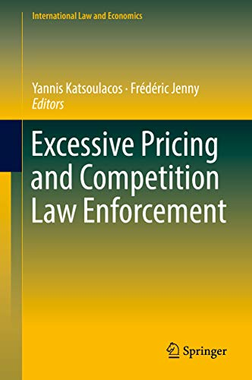
A summary of the experience in different countries
A summary of the Israeli experience, as well as of other countries, appears in “Excessive Pricing and Competition Law Enforcement,” Katsoulacos and Jenny (Eds.), 2018

Slide 26
The Israeli experience
The IAA published guidelines 14/1 "The prohibition of excessive pricing by a monopolist"
Following the guidelines, a tsunami of class actions: hard and soft cheese, heavy cream, dairy desserts, cocoa powder, green tea, margarine, instant coffee, coca powder, coca cola, Israeli couscous, cigarettes…
Three cases went all the way to the supreme court
  Gafniel (Coca Cola 1.5 litter)
  Naor (Cottage cheese)
  The Israeli Consumer Council (Hard cheese)
The Supreme court in Naor, March 2023: "The courts must take a particularly careful and restrained approach, when they come to decide on a class action regarding the claim of setting an extremely high and unfair price"
Class actions have an advantage if the plaintiff information that the antitrust authority does not have; otherwise why do we need them?

Slide 27
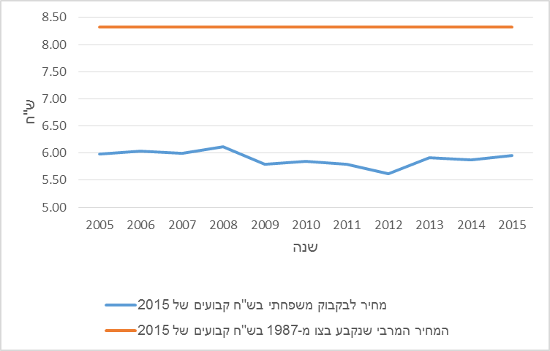
Gafinel (Coca Cola 1.5 liter)
The expert for the plaintiff argued that in the late 1980’s the price of Coca Cola was under price control and since deregulation it has increased by 350% (but forgot to mention that inflation rose since then by 462%...)
The real price (adjusted for inflation) is in blue and the regulated price from 1987 adjusted for inflation is in orange

Slide 28
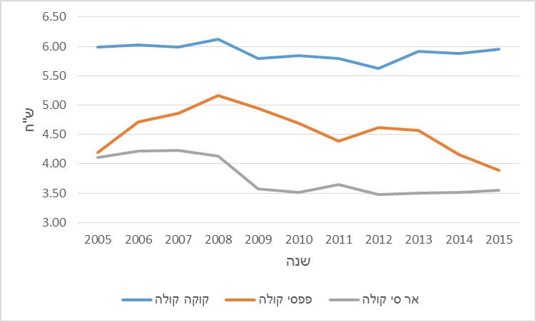
Gafinel (Coca Cola 1.5 liter)
The class action was certified because Coca Cola 1.5 liter is more expensive than Pepsi Cola and RC Cola
The Supreme court, July 2022: "Excessive price cases must be interpreted with extreme caution, and only in clear cases of consumer exploitation "stabbing the eye and clear to all.""

Slide 29
Naor (Cottage cheese)
The district court found that the price of cottage cheese is excessive based on 3 comparisons:
  Price decrease after consumer boycott in June 2011 (from 6.97 before to 5.62 after)
  Price cost margins (19.8%-22%)
  Comparison with the profitability of foreign dairies (12.1% on average)
Damages were computed based on the finding that the profitability on cottage cheese was above the profitability of Kraft Foods by 1%-3.5%
The Supreme court, March 2023: "The courts must take a particularly careful and restrained approach, when they come to decide on a class action regarding the claim of setting an extremely high and unfair price"

Slide 30
The UK pharma cases

Slide 31
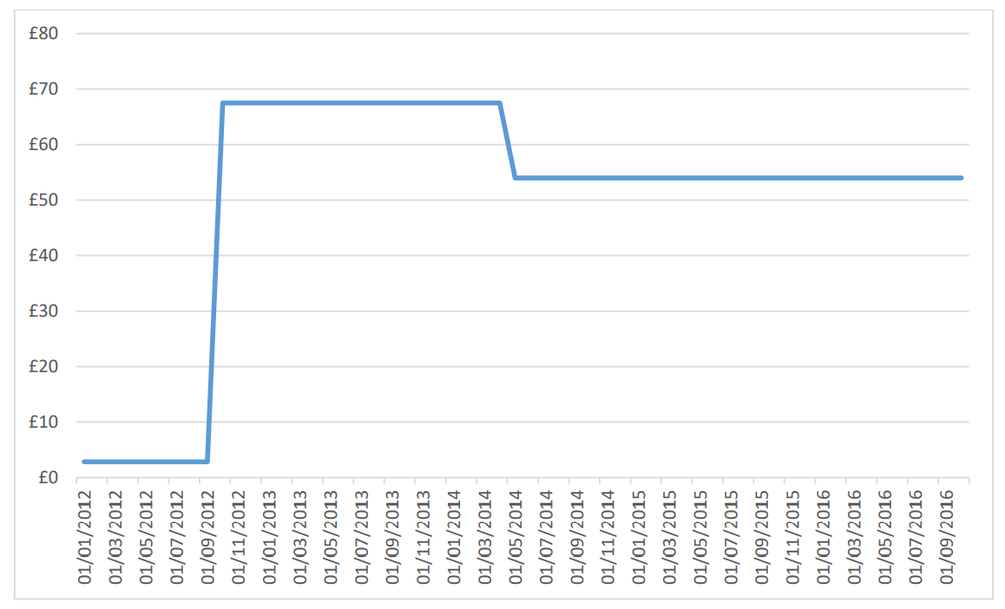
Phenytoin
100mg phenytoin sodium capsule, price per pack of 84 capsules
Sep 2012: debranding
From £2.21 to £51

Slide 32
Liothyronine
Advanz’s monthly average sales prices for liothyronine tablet packs, Jan 2007 – July 2017
Debranding in Oct 2007
From £4 to £248

Slide 33
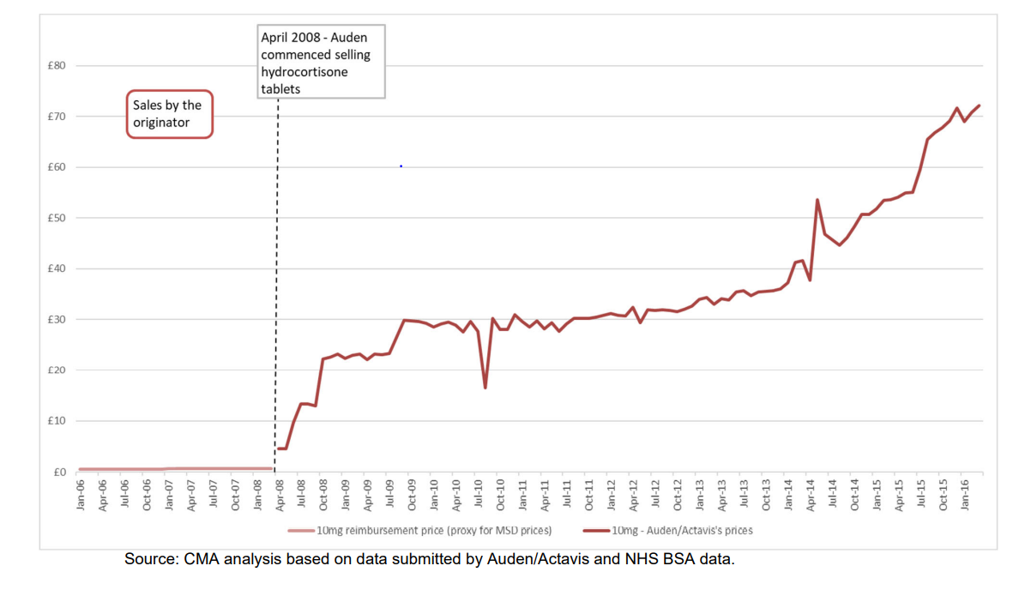
Hydrocortisone
10mg hydrocortisone tablet, price per pack of 30 tablets, Jan 2006- March 2016
Debranding in April 2008, pay for delay in 2012 (entry occurred only in 2015)
From less than £1 to £72

Slide 34
Hydrocortisone
10mg hydrocortisone tablet, price per pack of 30 tablets, April 2008- April 2021

Slide 35
Conclusion
Excessive pricing cases are problematic especially when they are brought by private litigants
There are few "easy" cases
Most are in the grey area:
  Regulatory failure – regulation of last resort
  Intervention can cause distortions
  Restrained approach: this tool should be reserved for rare cases

Slide 36
Additional considerations

Slide 37
Other considerations
Economic Value
  If Economic value = WTP, the question is "whose WTP"?
  The demand function has a whole range of WTP
Effective competition
  Perfect competition does not exist in a wide range of cases and is inappropriate
  A dominant firm is dominant precisely because perfect competition cannot exist

Slide 38
Excessive pricing cases made by the Italian Competition Authority (ICA)
September 2016 – The ICA fined Aspen over €5 million by increasing prices of its anti-cancer drugs by 300%-1,500% (the Council of State upheld the decision in February 2020)
March 2022 - The ICA fined ferry operator Caronte & Tourist (“C&T”) €3.7 million for having charged excessive prices on a ferry transportation route between Sicily and Calabria between 2017 and 2019
May 2022 - The ICA fined Leadiant €3.5 million for having charged excessive prices on an orphan drug to treat CTX; the price increased from €67 per pack of 100 pills to around €15,500 per pack

